Slide 1
IMAGE COMPRESSION USING DEEP LEARNING
MINOR PROJECT - 2 (DEEP LEARNING)
By ,
Sarath (160120737167)
Shiva Theja (160120737172)

Slide 2
ABSTRACT
Image compression is a process of reducing the size of an image while maintaining its quality. Traditional image compression algorithms such as JPEG use methods such as transform coding and quantization to achieve compression.
However, these methods can result in a loss of quality and detail in the compressed image. In recent years, CNNs have emerged as a powerful tool for image compression. The project on image compression using CNN aims to develop an image compression algorithm that can compress images while preserving their quality. This project involves building a CNN and Generative model that can learn to encode and decode images, compress and reconstruct images using the trained model, and evaluate the compression performance using metrics such as PSNR and SSIM. The project can have various uses, including improved storage efficiency, and faster image transmission.

Slide 3
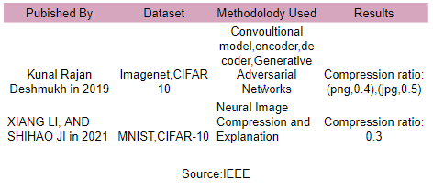
LITERATURE SURVEY

Slide 4
Operating System: Windows 10
Tools:
1.Python
2.Google colab
3.Keras
4.Tensorflow
Requirements

Slide 5
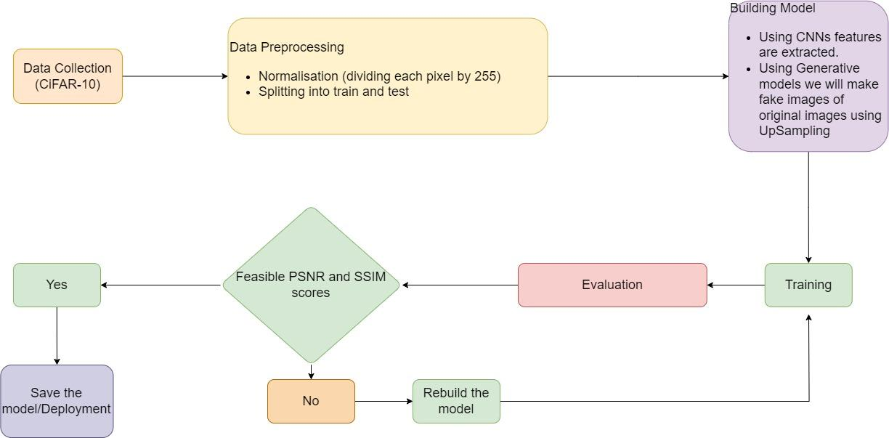
PROJECT FLOW

Slide 6
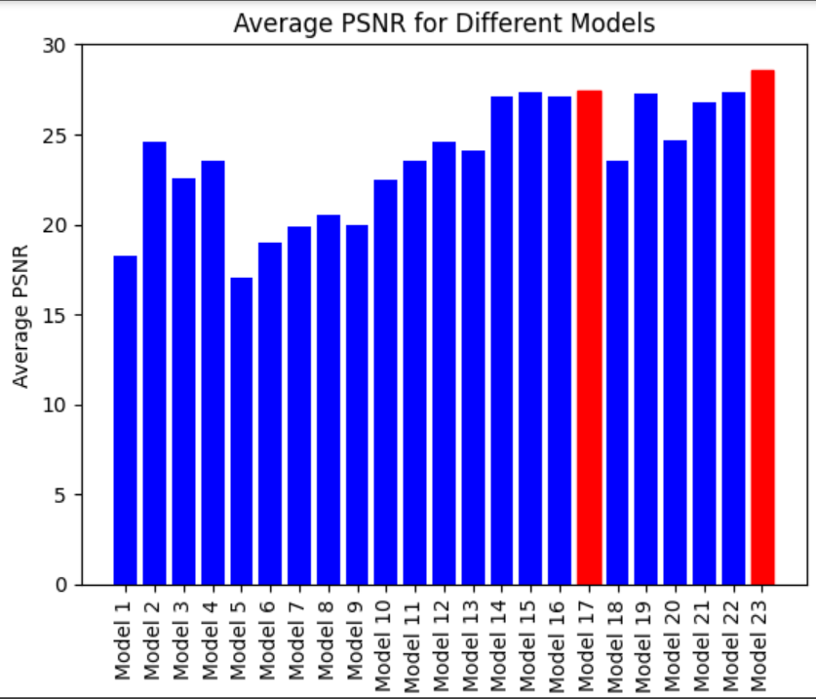
COMPARISON OF VARIOUS MODELS

Slide 7
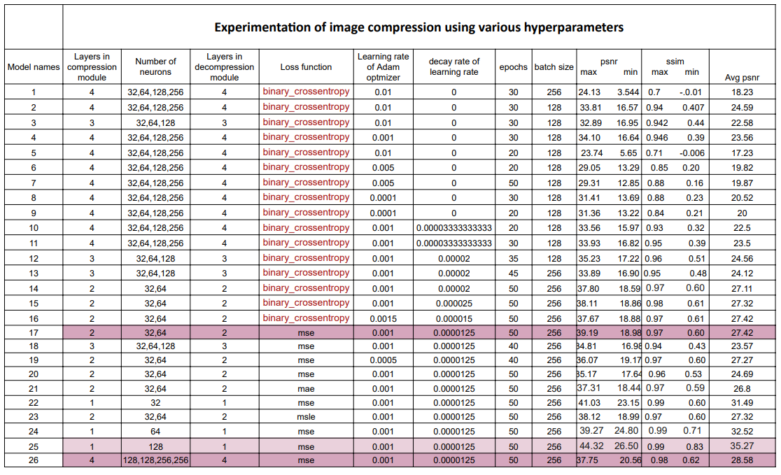
FINAL RESULTS

Slide 8
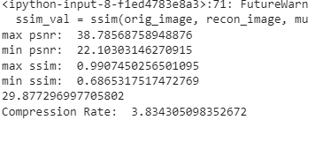
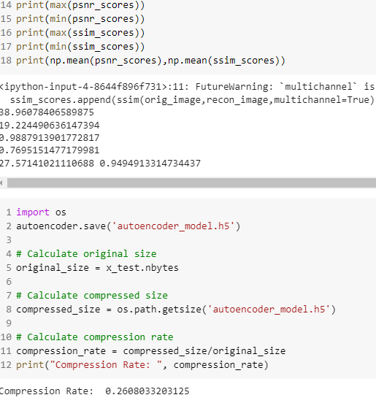
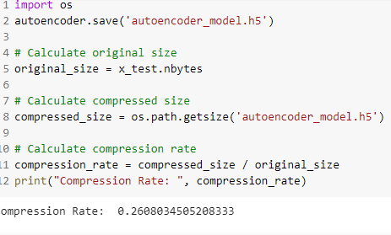
RESULTS FOR CIFAR-10 AND CIFAR-100

Slide 9
THANK YOU

